Slide 1
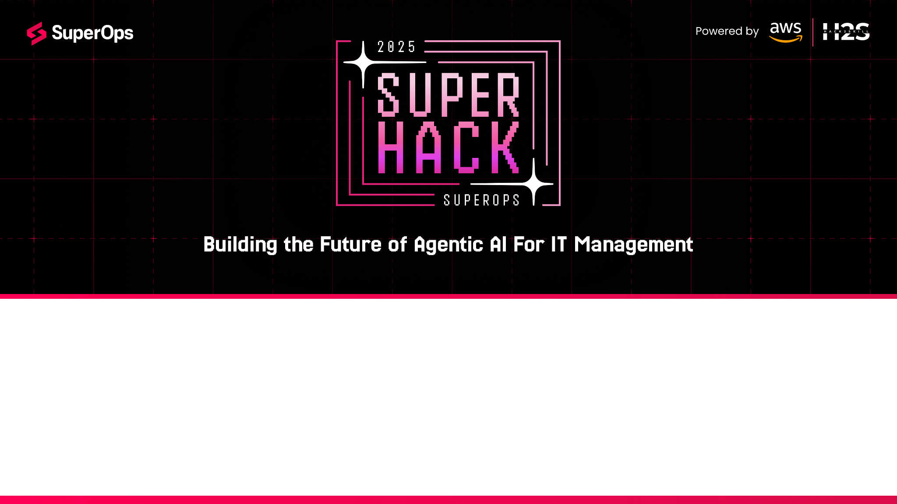
Team Name : BNSpace
Team Leader Name : Balaji Narayanamoorthy
Problem Statement : Operational Efficiency Improvement for MSPs and IT Teams

Slide 2
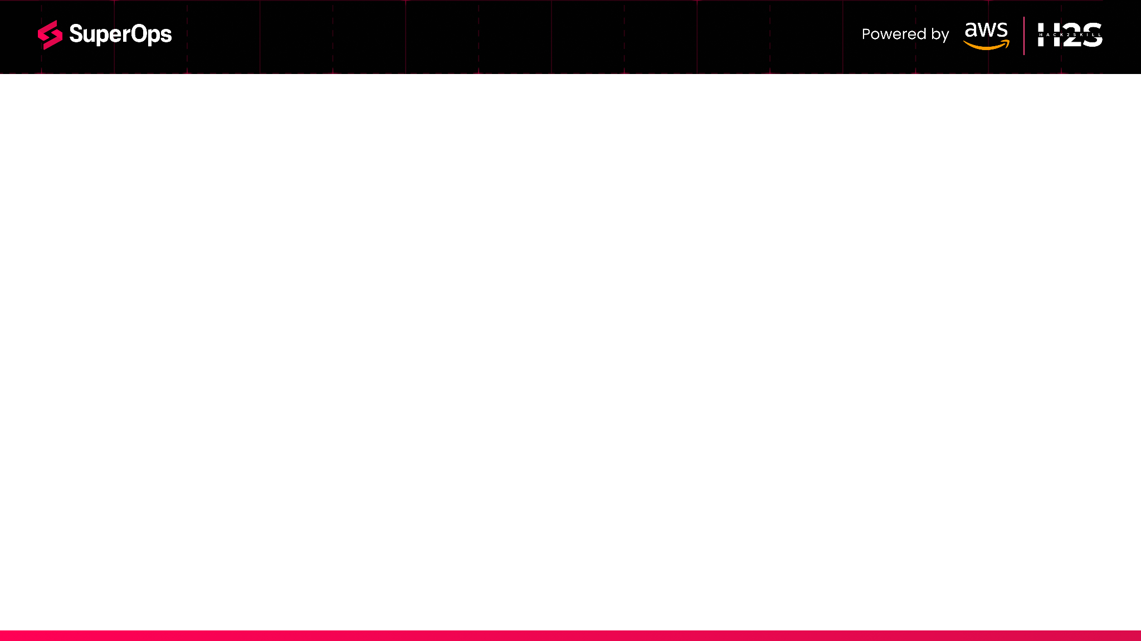
Brief about the Idea:
AutoOps AI is an Agentic AI-powered platform designed to make IT operations self-driving for MSPs and IT teams. It intelligently handles patch management, alert management, and routine IT administrative tasks by continuously monitoring systems, correlating alerts, prioritizing vulnerabilities, and triggering automated remediation — all within policy-defined guardrails.
Unlike traditional RMM tools that rely only on static scripts, AutoOps AI uses LLM-driven decision-making to analyze, decide, and act autonomously while learning from human feedback. This results in faster resolution, fewer missed incidents, and lower manual workload — directly improving operational efficiency and profitability for MSPs.

Slide 3
How different is it from any of the other existing ideas? AutoOps AI goes beyond traditional RMM and automation tools by using Agentic AI to not just execute pre-defined scripts but to analyze, decide, and act autonomously within safe guardrails. Unlike rule-based systems, it continuously learns from human feedback, improving accuracy and efficiency over time.
How will it be able to solve the problem? AutoOps AI directly addresses patch chaos, alert fatigue, and repetitive IT tasks by:
Prioritizing and scheduling patches intelligently to minimize downtime and maximize compliance.
Correlating and deduplicating alerts to reduce noise and focus on root causes.
Executing automated remediation and routine tasks such as service restarts, cleanup jobs, and user lifecycle actions — freeing engineers from manual work.
Providing a natural language interface so teams can query and control operations easily.
USP of the proposed solution:
Policy-driven autonomy: IT admins stay in control while AI handles the heavy lifting.
End-to-end coverage: Patch management, alert management, and task automation — all in one platform.
Continuous learning: AI adapts to the MSP’s unique environment, improving decision-making with every interaction.
Seamless integrations: Works with existing RMM, ticketing, and alerting tools, reducing adoption friction.

Slide 4
✅ Patch Management:
• Endpoint discovery, patch prioritization, safe rollout & rollback
✅ Alert Management:
• Noise suppression, correlation, AI-driven root cause analysis
✅ Automated IT Tasks:
• Service restarts, log cleanup, compliance enforcement, user lifecycle automation
✅ Policy-Driven Autonomy:
• Admins define guardrails, AI takes safe automated actions
✅ ChatOps Interface:
• Slack/Teams integration for approvals, real-time insights

Slide 5
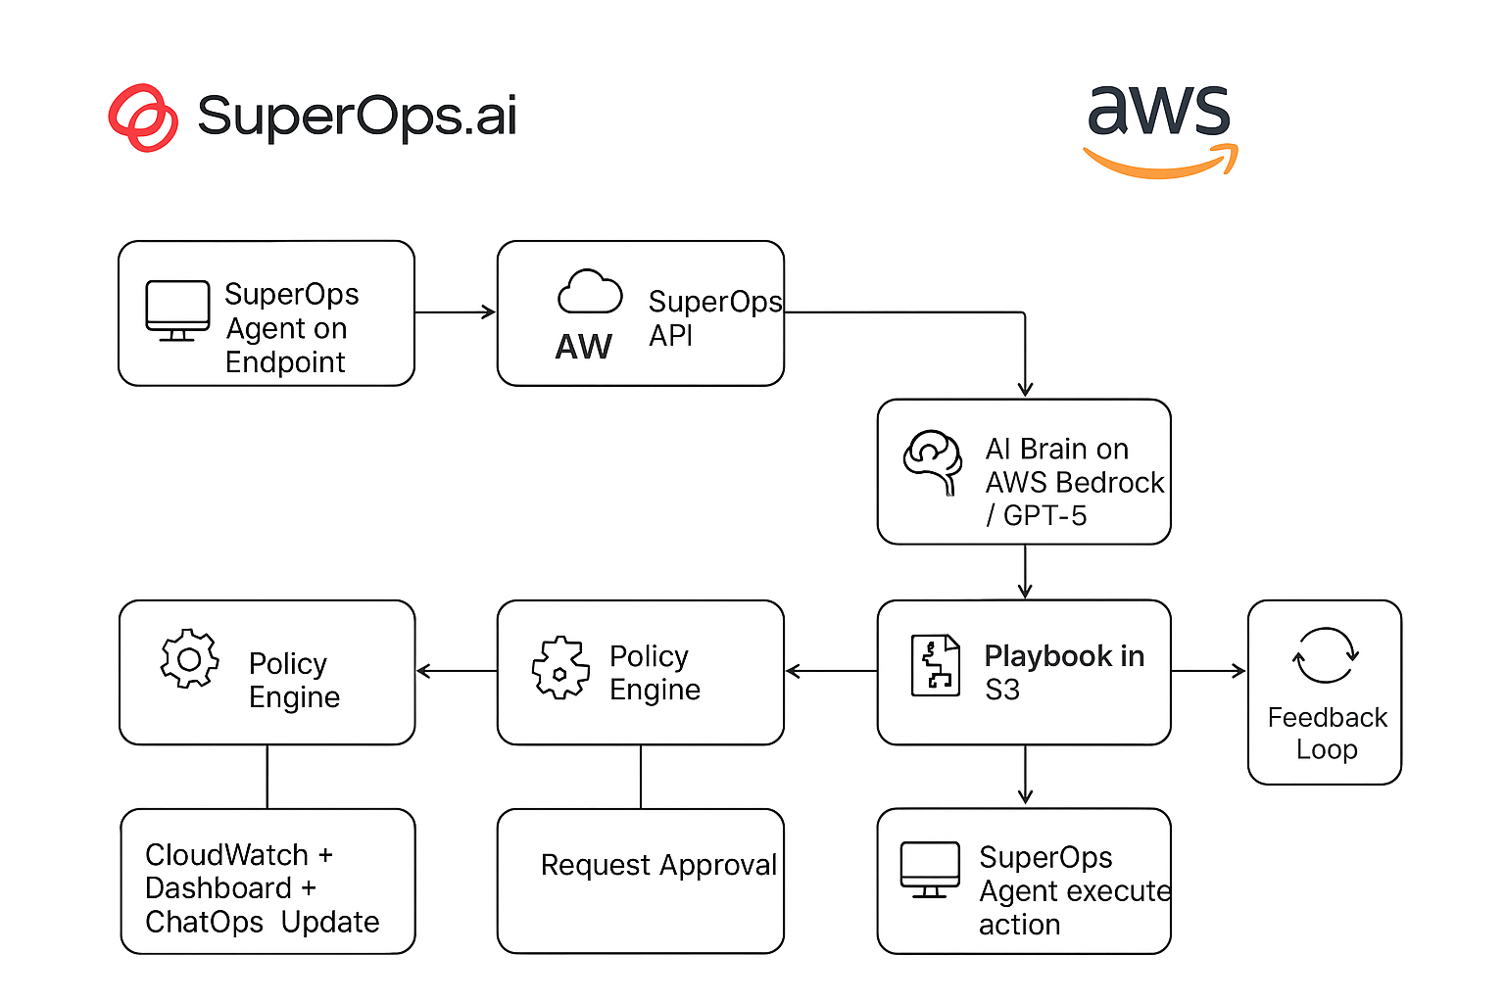
Process flow diagram or Use-case diagram

Slide 6
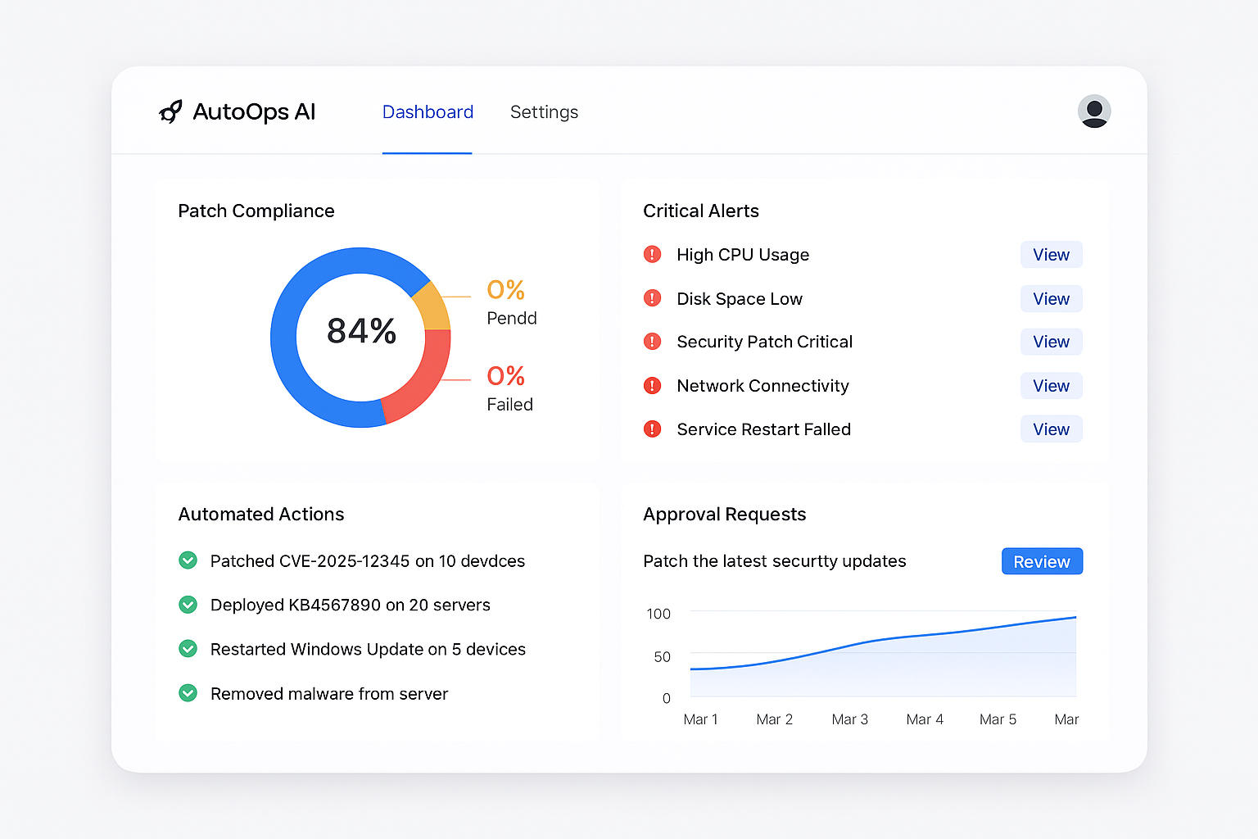
Wireframes/Mock diagrams of the proposed solution

Slide 7
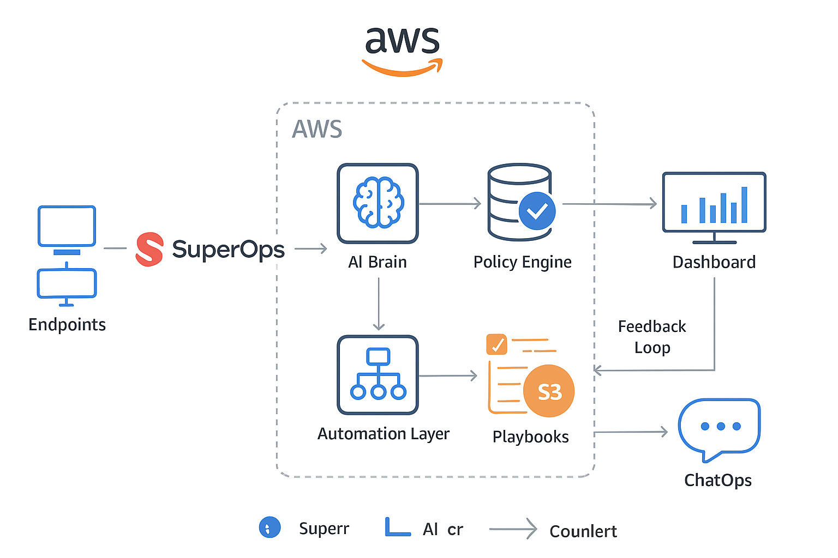
Architecture diagram of the proposed solution

Slide 8
Technologies to be used in the solution:
Layer | Technology / Service | Purpose
Endpoint Management | SuperOps.ai Agent & APIs | Collect device inventory, patch status, alerts, and execute remote scripts or patches.
AI & Orchestration | AWS Bedrock (or GPT-5 API) + LangChain / CrewAI | Reasoning engine to prioritize patches, correlate alerts, decide remediation actions.
Policy Engine | AWS DynamoDB (storing JSON/YAML policies) | Stores automation guardrails, thresholds, and rules for safe auto-remediation.
Automation & Remediation | AWS Lambda + AWS Step Functions | Event-driven execution of playbooks, connecting AI decisions with SuperOps agent actions.
Playbook Repository | AWS S3 | Stores patching scripts, remediation workflows, rollback scripts with version control.
Memory & Context | Amazon OpenSearch Service (Vector DB) | Maintains historical incidents, decisions, and user feedback for AI learning.
Monitoring & Logging | AWS CloudWatch + CloudTrail | Centralized logging, decision traceability, and auditing of AI actions.
Dashboard & UI | React + TailwindCSS (hosted on AWS Amplify) | Displays patch compliance, alerts, AI actions, and provides manual control.
ChatOps Interface | Slack/Teams Bot (AWS API Gateway + Lambda) | Approval workflow and natural language control of AutoOps AI actions.
Data Sources | NVD CVE API, Vendor Patch Feeds | Real-time vulnerability and patch information for prioritization.

Slide 9
Estimated implementation cost (optional):
Component | Tool/Service | Estimated Cost (1 Month) | Notes
LLM / AI Reasoning | AWS Bedrock (Claude/GPT-like) or GPT-5 API | ~$100 – $150 | Assume ~50k–100k tokens/day during dev & testing
Compute (Backend) | AWS Lambda, API Gateway | <$30 | Pay-per-use, no servers required
Workflow Orchestration | AWS Step Functions | ~$10 | Low-cost for small number of flows
Data & Storage | DynamoDB (policy store), S3 (playbooks) | <$10 | Minimal storage footprint
Monitoring & Logs | CloudWatch, CloudTrail | ~$15 | Audit + log retention for demo
SuperOps Agent + API | Existing RMM Agent | Included (SuperOps sandbox or trial) | No extra cost for hackathon prototype
Frontend Hosting | AWS Amplify (React dashboard) | ~$5 | For demo UI hosting
Slack/Teams Bot | AWS Lambda + API Gateway | ~$5 | Minimal execution cost
Miscellaneous | Testing, CI/CD, small EC2 for simulations | ~$50 | Optional if you spin up test endpoints

Slide 10
